Slide 1
SOFTWARE DEVELOPMENT LIFE CYCLE
by
SUPRAJA C

Slide 2
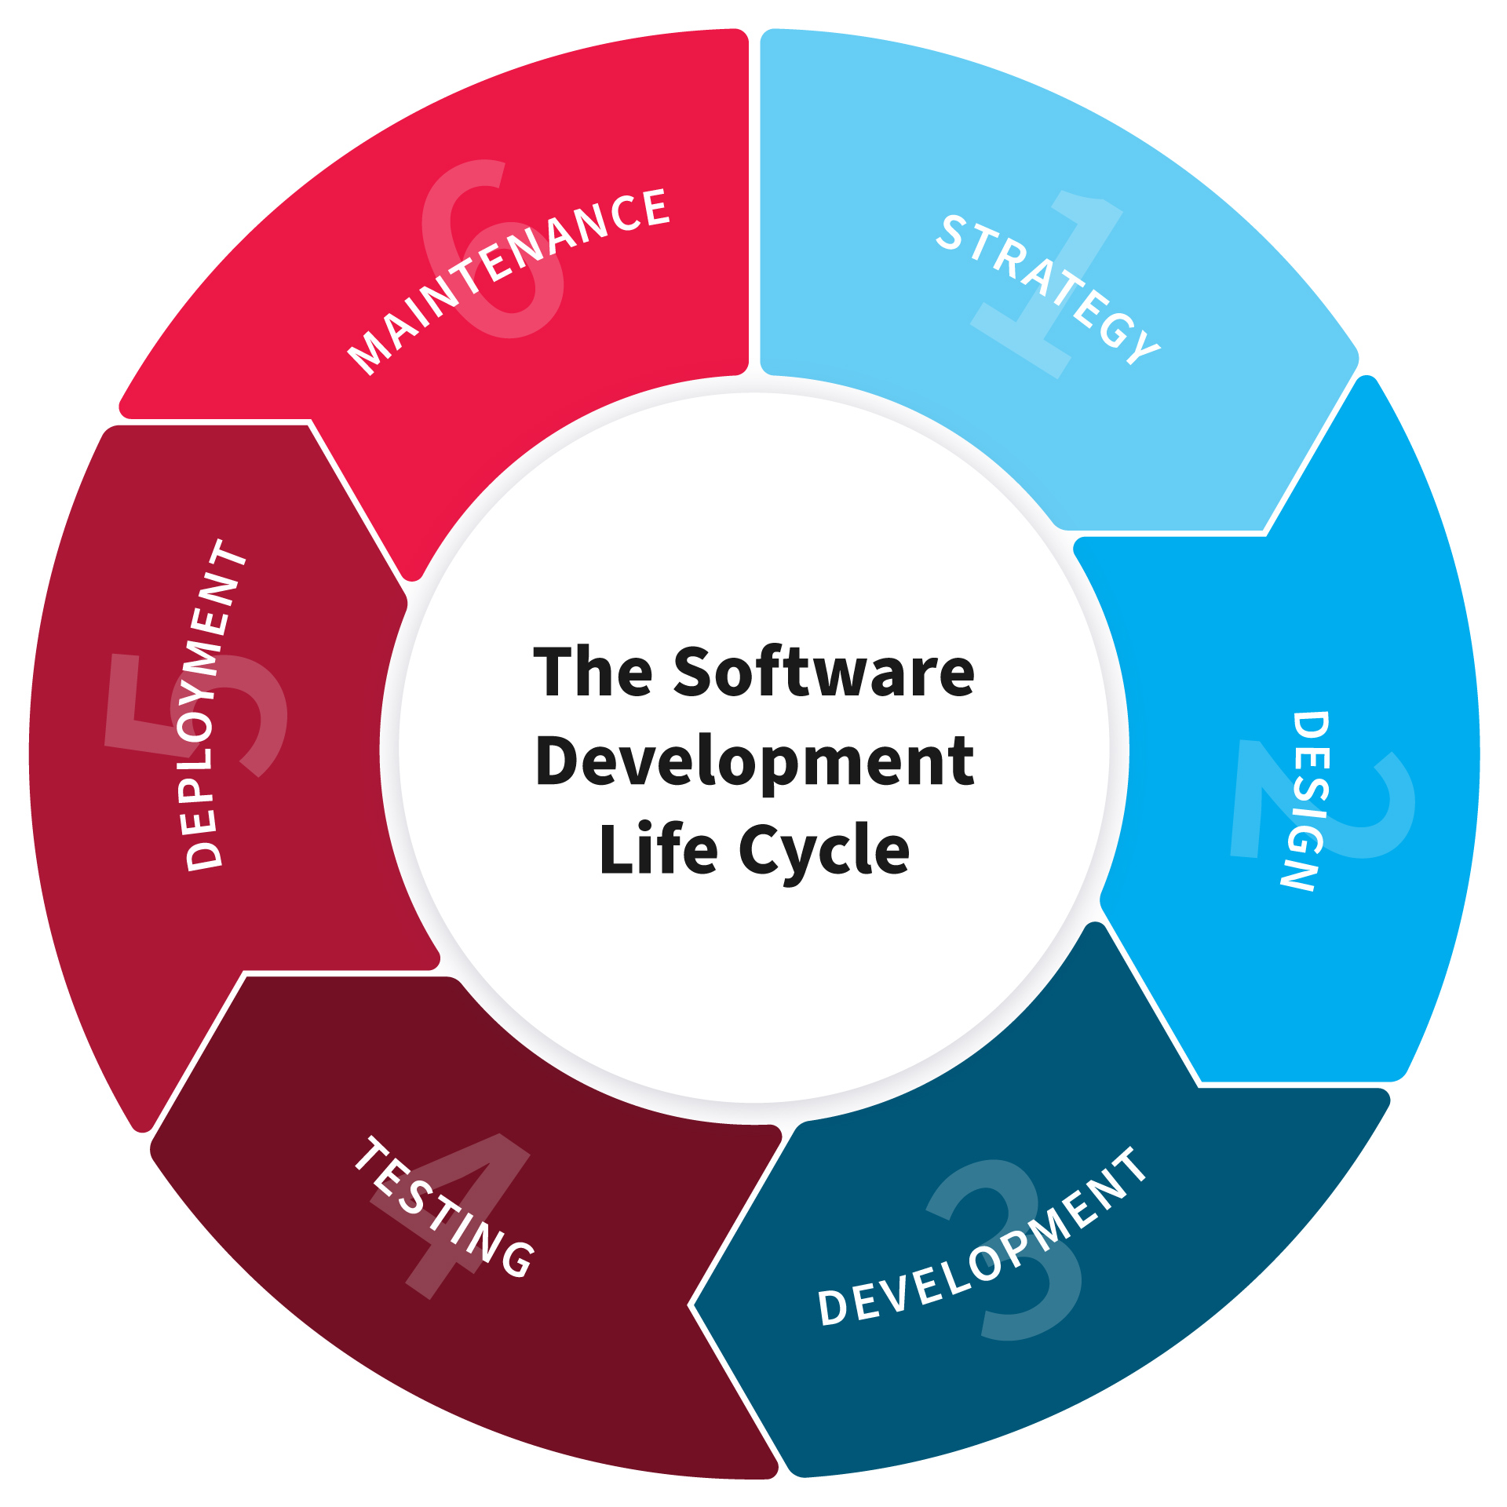
SDLC
SDLC - Software Development Life Cycle.
SDLC is a process used by the software industry to design, develop and test high quality software.
It is also called as Software Development Process.
SDLC is a framework defining tasks performed at each step in the software development process.

Slide 3
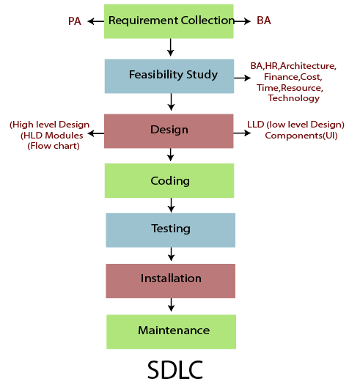

Slide 4
REQUIREMENTS
A condition or capability needed by a user to solve a problem or achieve an objective.
DESIGN
The process of defining the architecture, components, interfaces, and other characteristics of a system or component.
CODING
The process of transforming the design of a system into a computer language format.
TESTING
The process of evaluating and verifying that a software product or application does what it is supposed to do.
MAINTENANCE
The main purpose is to modify and update software application after delivery to correct faults and to improve performance.

Slide 5
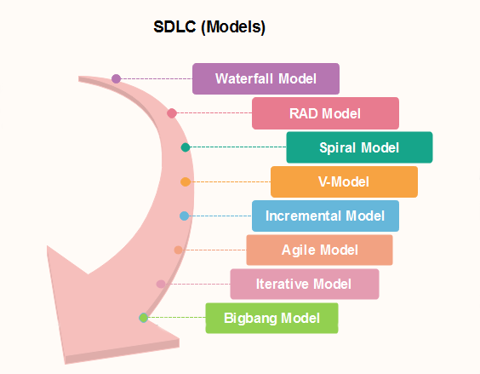
SDLC Models

Slide 6
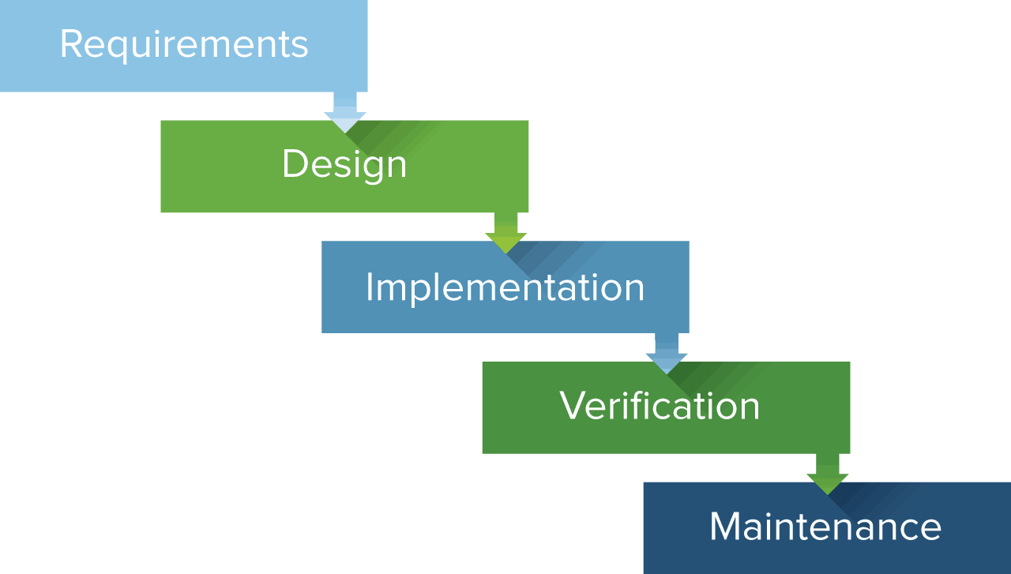
WATERFALL MODEL
The waterfall is a classical model used I system development life cycle to create a system with a linear and sequential approach

Slide 7
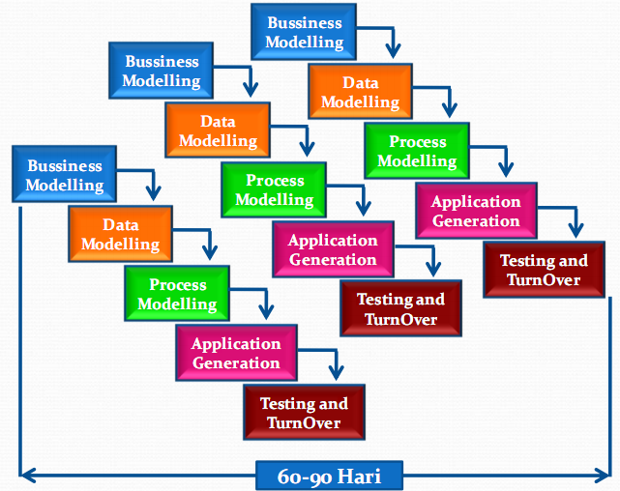
RAD MODEL
The Rapid Application Development (or RAD) model is based on prototyping and iterative model with no (or less) specific planning

Slide 8
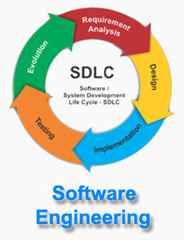
SPIRAL MODEL
The spiral model is similar to the incremental development for a system, with more emphasis placed on risk analysis.

Slide 9
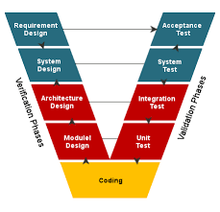
V MODEL
The V-model is an SDLC model where execution of processes happens in a sequential manner in a V-shape. It is also known as Verification and Validation model.

Slide 10
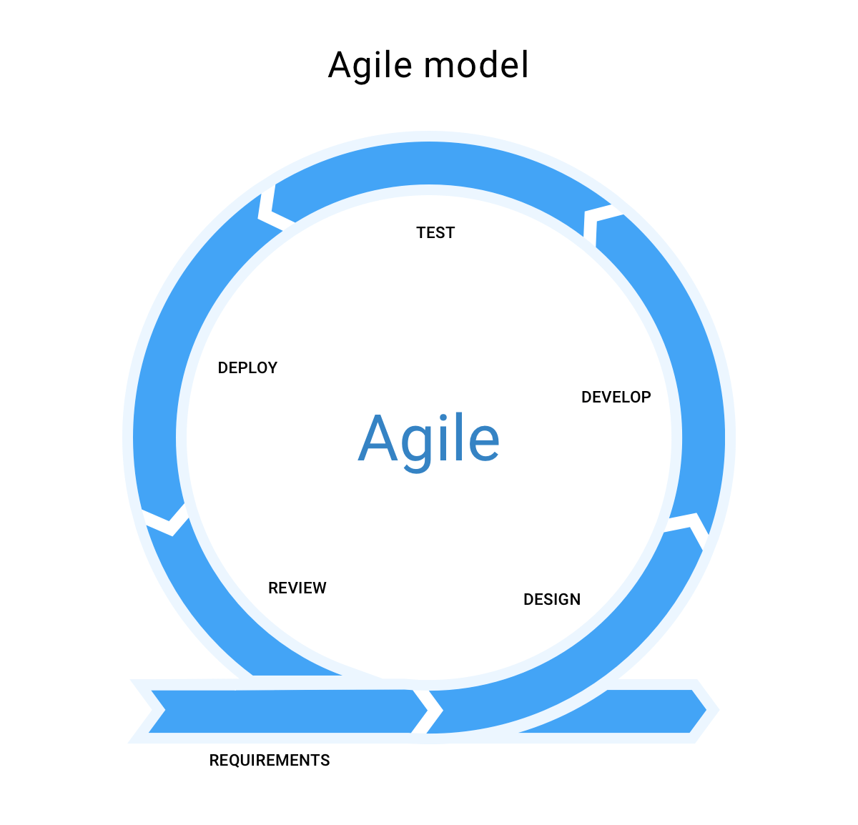
AGILE MODEL
The Agile model adopts Iterative development. Each incremental part is developed over an iteration. Each iteration is intended to be small and easily manageable and that can be completed within a couple of weeks only.

Slide 11
THANK YOU!

